Slide 1
The story behind Module 1
CYBER 262

Slide 2
Basic Concepts
Events
Program behavior
Logs

Slide 3
What is an event
An event = “something has happened on a PC”
Not all events are interesting to a security officer
The security officer will focus on certain classes of events

Slide 4
Events: an analogy
Inside the classroom:
Event 1: Student John walks in
Event 2: John goes to the blackboard
Event 3: John reads a line of words on the blackboard
Event 4: John comprehends the line of words in his brain
Event 5: John modified 3 words on the blackboard
Event 6: John walks out of the classroom
Six events have happened!

Slide 5
Events on a computer
Program X reads a block of bytes from a file on the disk
Program X modified 3 bytes in the block in the DRAM memory
Not very interesting to the security officer
Program X writes the modified block back to the file on the disk
A “read” event
A “write” event

Slide 6
Event classes
“read” events and “write” events are very different
“read” events will not modify anything
“write” events will modify bytes on a disk
“read” events and “write” events are two classes of events

Slide 7
The event classes that concern us in Module 1
Event Class | Meaning | Keywords
Program execution | A application program starts running | execve
Modification (i.e., write) | Something is written somewhere. The application program can write to the console screen or some files. | write
Read | Read from somewhere. The application program can read from a file; it can also read from console keyboard input. | read
Get file status | Verify if a file exists, who owns the file, and if the file is executable, writable, or readable. | access/stat
File unlinking | Unlink a file from a specified position in the file system. After unlinking, the operating system will think that this file does not exist there. | unlinkat
Program end | A program ends execution. A normal exit will signal “0”. Exiting with none-zero value marks the existence of one or more errors during execution. | exit_group

Slide 8
What is program behavior
Program Behavior = a sequence of events
Every event has a timestamp telling when it happened
The sequence of events is ordered by time

Slide 9
Program behavior: An analogy
Inside the classroom:
Student John walks in
John goes to the blackboard
John reads a line of words on the blackboard
John comprehends the line of words in his brain
John modified 3 words on the blackboard
John walks out of the classroom
Inside a PC
Program X starts to run
Program X accesses the disk
Program X reads a block of bytes from a file on the disk
Program X processes the block of bytes in the DRAM (memory)
Program X modified 3 bytes in the block in the DRAM
Program X writes the modified block back to the file on the disk
Program X exits
A sequence of events

Slide 10
What is a log
A log file is a recording of program behavior
You can find two example log files in the “Module 1” folder on Canvas
Each log file contains a sequence of events

Slide 11
Overview (1): a program that helps you count how many keystrokes
Good
User
After
count_keystrokes.c
is
compiled
Count_keystrokes.c is a C program; this program has a security vulnerability!
Hacker

Slide 12
Overview (2)
Good
User
Output
(How many keystrokes
are typed in)
Program
count_keystrokes.exe
is
running
Keystrokes
Observe program behavior
Tracer
= observe &
record
Log file

Slide 13

Overview (3): a program that helps you count how many keystrokes
Program
count_keystrokes.exe
is
running
Some inputs
Hacker
Do something malicious…
Observe program behavior
Tracer
= observe &
record
Log file

Slide 14
Goal of Module 1
The goal is to implement a simple intrusion detector
You will be given two log files which are mentioned in the previous two slides, respectively
You are asked to write Python scripts to:
Conduct keyword search to find interesting events
Analyze the security-related event classes
Analyze the suspicious event sequences
Good news: we will provide you with some example Python scripts

Slide 15
Details: when nobody is attacking
C source code: count_keystrokes.c
int main(int argc, char *argv[]) {
printf("Try to exec /bin/sh");
vuln();
return 0;
}
What events are happening?
The vulnerable program starts;
Something is written to console;
The vulnerable function is called!

Slide 16
Details: when nobody is attacking
C source code: count_keystrokes.c
int vuln() {
char buf[80];
int r;
r = read(0, buf, 400);
printf("\nRead %d bytes. buf is %s\n", r, buf);
puts("No shell for you :(");
return 0;
}
A character array w/ 80 bytes is defined
An integer variable r is also defined
But a maximum of 400 characters can be read! The actual number of keystrokes is stored into r.
Count the number of keystrokes, and print out the original keystrokes (Note that ENTER key is also counted as one)
Another string is printed out
Return to caller function main()

Slide 17
Details: when nobody is attacking
C source code: count_keystrokes.c
int main(int argc, char *argv[]) {
printf("Try to exec /bin/sh");
vuln();
return 0;
}
Function main() returns, and the program ends

Slide 18
Details: What the Attacker is doing
To achieve the learning objective of this module, I will hide something from you:
In one of the two log files, some events are malicious
But I am not going to tell you which events are malicious; it is your job to find out
The attacker’s goal is to execute some malicious code written by himself
In this attack, these code is called shell code
The shell code are NOT part of the original program

Slide 19
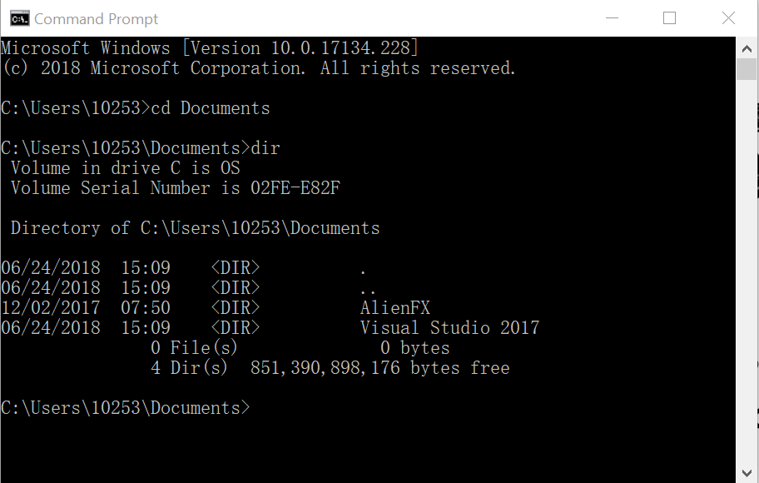
What is shell code?
CYBER 100 teaches command line commands
Windows command line (cmd.exe)

Slide 20
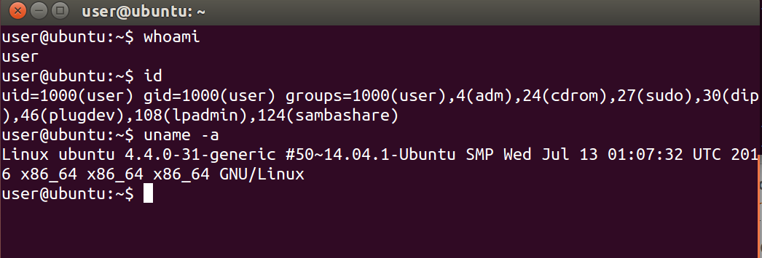
What is shell code?
CYBER 100 teaches command line commands
Windows command line
Linux command line (bash)

Slide 21
What is shell code?
CYBER 100 teaches command line commands
Windows command line
Linux command line
Shell code is related to a Unix shell, a special application (program) that provides a command line user interface
Shell code is a sequence of machine-level instructions
One of these instructions will execute a shell application program
Shell code enables the attacker to run some command line commands

Slide 22
How can the shell Code get executed?
How do instructions get executed in a computer?
Programs are compiled to binary files to get executed. When a program starts to be executed, its binary content, which contains machine-level instructions, is stored into memory
How does a computer know where the binary instructions are stored?
→CPU in a computer uses a register to remember the position in the memory where the next instruction is stored
In order to get the shell code executed, it first needs to be stored into memory. Then we need to know where it is stored to overwrite the register to this position.

Slide 23
How can the shell Code get executed?
Where are variables stored when programs are running?
In the memory space allocated for the program by operating system.
What happens when more than 80 characters are input into an array which is supposed to store at most 80 characters?
Memory addresses which do not belong to the array are also overwritten. This is the vulnerability we leverage here.
OK, so now we can overwrite value in memory addresses which are not supposed to be overwritten. How to overwrite the register by such vulnerability?
When a function is called, the original register’s value is stored somewhere in memory, and then this value is set to the position where the called function is; when the function returns, this value is restored to let the program continue.
Use such vulnerability to overwrite this value to let CPU execute shell code!

